Slide 1
19th IEEE International Conference on Emerging Technologies (ICET 2024)
GIK Institute of Engineering Sciences and Technology

Slide 2
Please write the session ID # as per conference program
Write the title of your paper here and paper ID # also
Write all authors name, their affiliation and Presenter Name

Slide 3
Guidelines
Total Time is 15 Minutes for presentation and 3-5 minutes for Q&A Session.
Presentation should ideally cover the research gap, problem statement, methodology, important findings by the authors and the concluding remarks.
Referencing style should be the same as that of IEEE.
Reference on a slide should appear as foot notes on the same slide.
Figures should be easily visible and of good quality.
Avoid lengthy sentences, avoid putting too much text on a single slide.

Slide 4
Presentation Outline
Introduction
Problem Statement
Literature Review
Proposed Methodology
Results Comparison
References

Slide 5
Introduction
Please introduce the area in general
Give 2, 3 examples of the sub-area that you are working in
Introduction slide should only be limited to 1 slide only

Slide 6
Problem Statement
Write the problem statement here
Please do not write the solution here – it should appear in the next slides

Slide 7
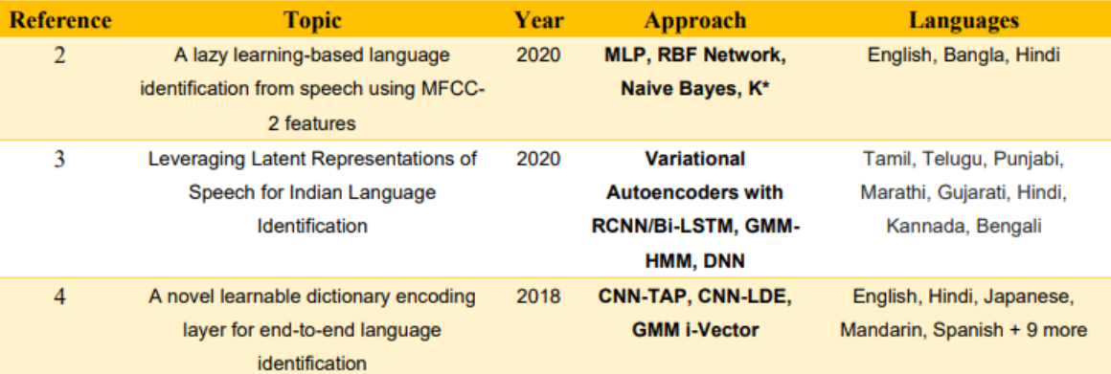
Literature Review

Slide 8
Proposed Methodology

Slide 9
Proposed Methodology

Slide 10
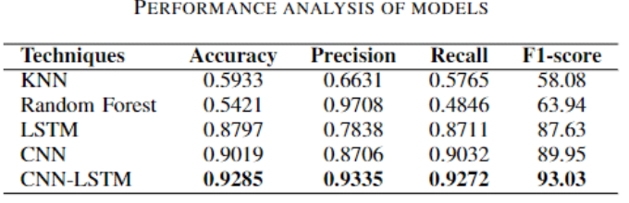
Results Comparisons

Slide 11
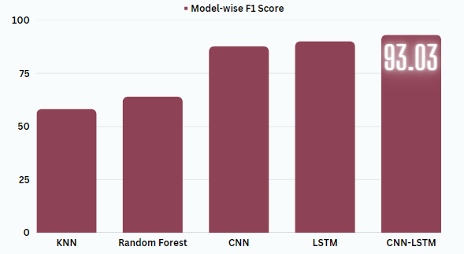
Results Comparisons

Slide 12
Concluding Remarks and Future Work

Slide 13
References
H. Mukherjee, S. M. Obaidullah, K. C. Santosh, S. Phadikar, and K. Roy, "A lazy learning-based language identification from speech using MFCC-2 features," International Journal of Machine Learning and Cybernetics, vol. 11, no. 1, pp. 1-14, Jan. 2020.
S. Karmakar and P. R. Krishna, "Leveraging Latent Representations of Speech for Indian Language Identification," in Proceedings of the 17th International Conference on Natural Language Processing (ICON), Dec. 2020, pp. 334-340.
W. Cai, Z. Cai, X. Zhang, X. Wang, and M. Li, "A novel learnable dictionary encoding layer for end-to-end language identification," in 2018 IEEE International Conference on Acoustics, Speech and Signal Processing (ICASSP), Apr. 2018, pp. 5189-5193.

